Slide 1
Course Introduction

Slide 2
Here some info about TAs & I
张文灏 11812103@mail.sustech.edu.cn
龙瀚，11812008@mail.sustech.edu.cn
汪泱泱，11812014@mail.sustech.edu.cn
尹沛骐 11810305@mail.sustech.edu.cn
Me 王维语 wangwy@mail.sustech.edu.cn
Inovation Park, Building 10, 5th floor 509(temporary)

Slide 3
Here some info about this Lab
Assignment: 20%
Lab: 30%
Final Exam: 40%
Attandance: 10%

Slide 4
Syllabus
[Lab 1] 稳定匹配算法的流程回顾、测试用例的构造技巧
[Lab 2] 练习编写稳定匹配算法
[Lab 3] 编写运行时间调查程序，在本机测试n、nlogn、n2等不同时间复杂度下，随着问题规模的增长运行时间的变化
[Lab 4] 运用BFS或者DFS解决一些图搜索问题
[Lab 5] 运用拓扑排序算法解决一些常见问题，如排课或安排项目计划
[Lab 6] 运用所学的贪心算法知识解决区间调度问题
[Lab 7] 运用所学的MST算法解决一些MST相关的问题
[Lab 8] 运用Huffman编码算法解决一些编解码问题
[Lab 9] 结合先修课程的算法解决综合性的问题
[Lab 10] 分治算法的简单应用
[Lab 11] 分治算法的综合应用
[Lab 12] FFT算法应用
[Lab 13] 运用所学知识解决简单背包问题
[Lab 14] 运用所学知识解决综合性的背包问题
[Lab 15] 网络流算法讲解及应用例题讲解
[Lab 16] 总结、复习、答疑

Slide 5
Recursion
CS208
Lab Class 4&5
Lab 00
by wwy 2021.01.14

Slide 6
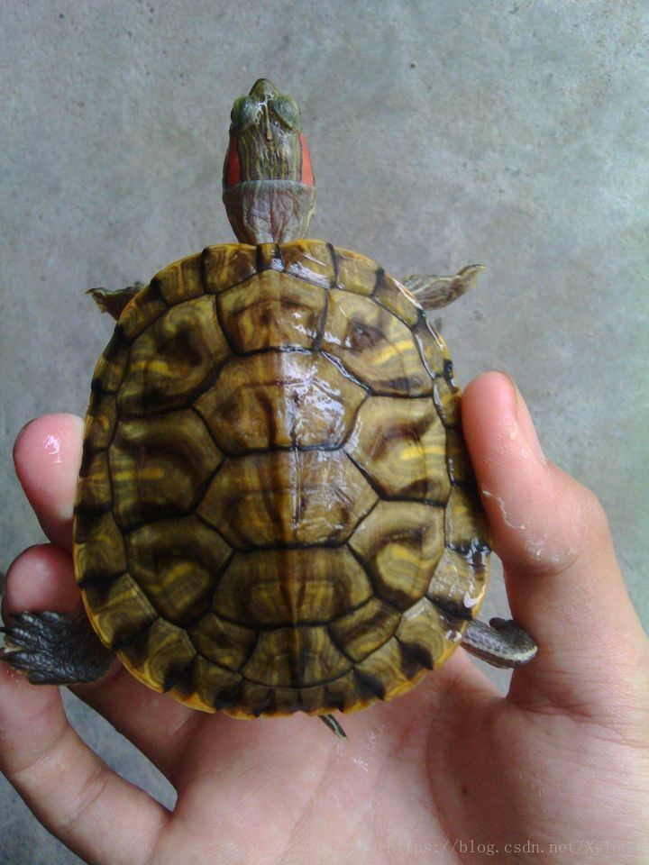
What is Recursion
Call the function itself
f(x) = x+f(x-1)
if x=3
f(3)=3+f(2)
=3+2+f(1)
=3+2+1+f(0)
......

Slide 7
Base case is Needed!
Only Repeat, Never Return
A trap...

Slide 8
Another Two traps
No guarantee of convergence
Excessive memory requirements
Guess
Crash Down...

Slide 9
Stack & Heap
Stack
Heap
continuous
temp
fast
local val
discontinuous
longer lifetime
lower
globle val

Slide 10
Thinking about it...
Program for Tower of Hanoi
Tower of Hanoi is a mathematical puzzle where we have three rods and n disks. The objective of the puzzle is to move the entire stack to another rod, obeying the following simple rules:
Only one disk can be moved at a time.
Each move consists of taking the upper disk from one of the stacks and placing it on top of another stack i.e. a disk can only be moved if it is the uppermost disk on a stack.
No disk may be placed on top of a smaller disk.

Slide 11
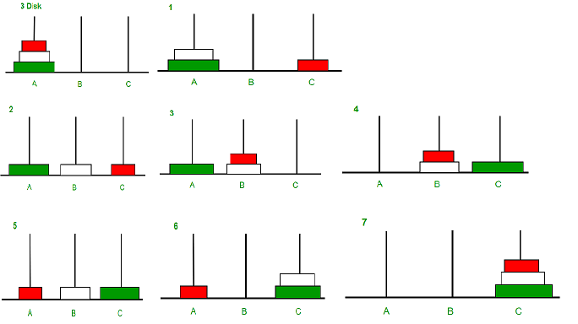
Tower of Hanoi
Input : 2
Output : Disk 1 moved from A to B
Disk 2 moved from A to C
Disk 1 moved from B to C
Input : 3
Output : Disk 1 moved from A to C
Disk 2 moved from A to B
Disk 1 moved from C to B
Disk 3 moved from A to C
Disk 1 moved from B to A
Disk 2 moved from B to C
Disk 1 moved from A to C
ref: https://www.geeksforgeeks.org/c-program-for-tower-of-hanoi/

Slide 12
THX ;-)
Good Luck!

Slide 13
Stable Matching
CS208
Lab Class 4&5
Lab 01
by wwy 2021.01.11

Slide 14
Algorithm brief
A
D
DEF
ABC
B
E
DEF
BCA
C
F
DEF
CAB

Slide 15
Algorithm-->Code
Same Num
Men list
choose list
Women list
choose list
Match rule
Test Entrance

Slide 16
Men/Women list & choose list
Flag Boolean？
Single or have a couple
Couple Num
Choose list
Men/Women x n
Flag int
Flag int
List
Class

Slide 17
Match Method
N Men & N Women
Who Come First？
Different Situations：
Object is single
Object have a couple, but more love you
Object have a couple, and more love the couple
Someone Sucess, Someone Fail
Be a couple
Be a couple
Fail

Slide 18
Match Method
Loop conditions
Finish conditions

Slide 19
Some Notices
Loop/Finish conditions
Statement change
Suitable Comments

Slide 20
THX ;-)
Good Luck!

